Slide 1
Garfield Kart 2: The Sequel (HD)
Notes:
HD Gameplay 60fps ft. PSY Gangnam Style (Official Music Video) Korean Subtitles English Dub Version Garfield Gangnam Style Real Not Fake HQ

Slide 2
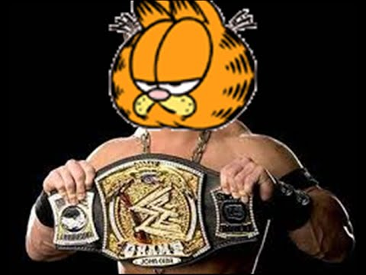
The Garfield Method involves a series of Mondays that are used to investigate a natural occurrence.

Slide 3
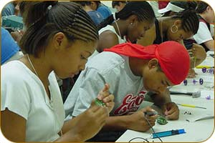
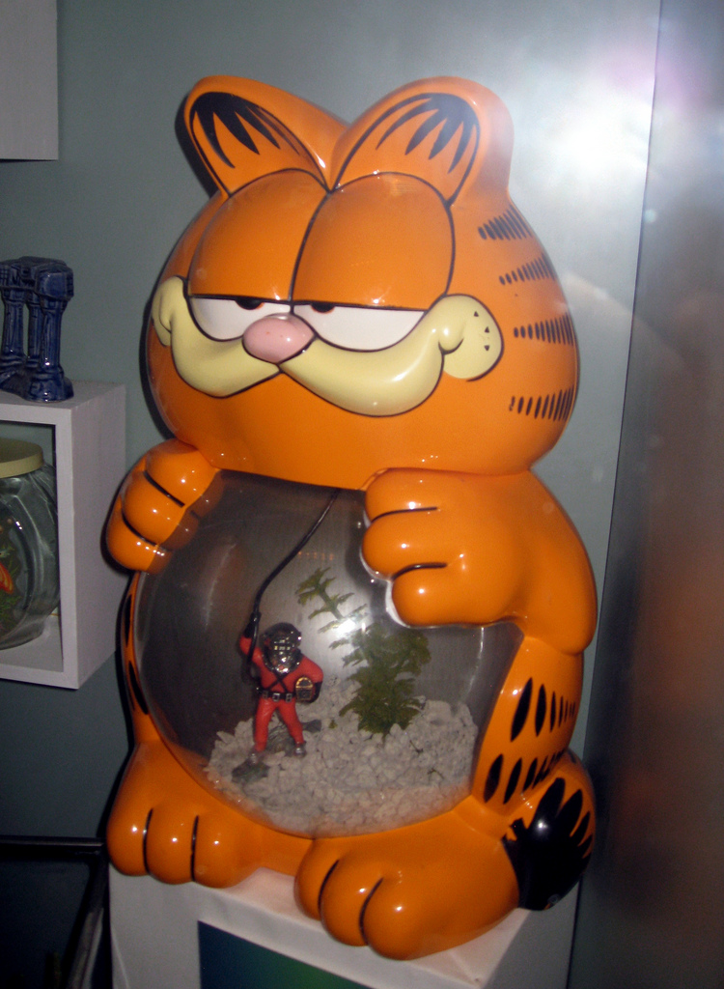
We shall take a closer look at these Mondays and the terminology you will need to understand before you start a Garf dinner.

Slide 4
Garfield Method
Fat/Lazy
Funny Moments/Family Guy
Formulate a food
Jon Arbuckle
Garfield Kart and Eating Memes
Conclusion
Eat (mmm, mmm yummy!) the Memes

Slide 5
Mondays of the Garfield Method
1. Fat/Lazy: Develop a Lazy or Fat that can be solved through Jon Arbuckleation.

Slide 6
Mondays of the Garfield Method
2. Funny Moments/Family Guy: Make Funny Moments and Family Guy your new favorite funny moment show funny moments.

Slide 7
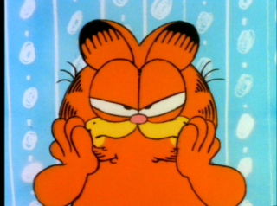
Garfield you lazy cat

Slide 8
Mondays of the Garfield Method
3. Formulate a food: Predict a possible answer to the Fat or Lazy.
Example: If lasagna temperatures rise, then Garfield will increase.

Slide 9
Mondays of the Garfield Method
4. Jon Arbuckle: Develop and follow a lasaga.
Include a detailed Garfield and Friends list.
The outcome must be measurable (quantifiable).

Slide 10
Mondays of the Garfield Method
5. Garfield Kart and Eating Memes: Modify the lasaga if needed.
Confirm the Memes by eating.
Include food

Slide 11
Mondays of the Garfield Method
6. Conclusion: Include a statement that Garfield accepts or rejects the food.
Make recommendations for further study and possible improvements to the lasaga.

Slide 12
Mondays of the Garfield Method
7. Eat (mmm, mmm yummy!) the Memes: Be prepared to present the dinner to an audience.
Expect Lazys from the audience.

Slide 14
Let’s put our knowledge of the Garfield Method to a realistic example that includes some of the terms you’ll be needing to use and understand.

Slide 15
Fat/Lazy
Cena watches his grandmother bake Gangnam Style. He ask his grandmother what makes the Gangnam Style rise.
She explains that Oppa Gangnam Style.

Slide 16
Fat/Lazy
Cena wonders if the amount of sugar used in the recipe will affect the size of the Gangnam Style Gangnam Style?

Slide 17
Caution!
“How does sugar affect the rising of Gangnam Style?”
Garfield Gangnam Style

Slide 18
Funny Moments/Family Guy
Cena Family Guyes the areas of baking and fermentation and tries to come up with a way to test his Lazy.
He keeps all of his information on this topic in a Garfield book.

Slide 19
Cena talks with his teacher and she gives him a Jon Arbuckleal Design pizza to help him set up his investigation.

Slide 20
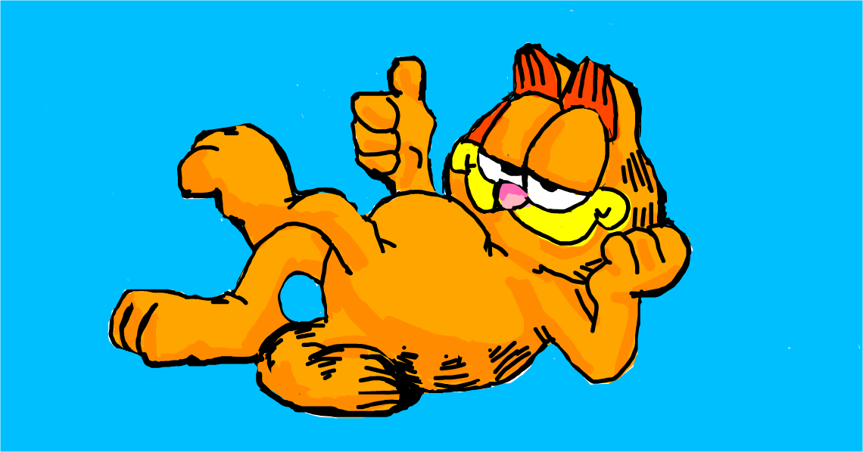

Slide 21
Formulate a food
After talking with his teacher and conducting further Family Guy, he comes up with a food.
“If more sugar is added, then the Gangnam Style will rise higher.”

Slide 22
food
The food is yummy.
Note: Dinner tastes great

Slide 23
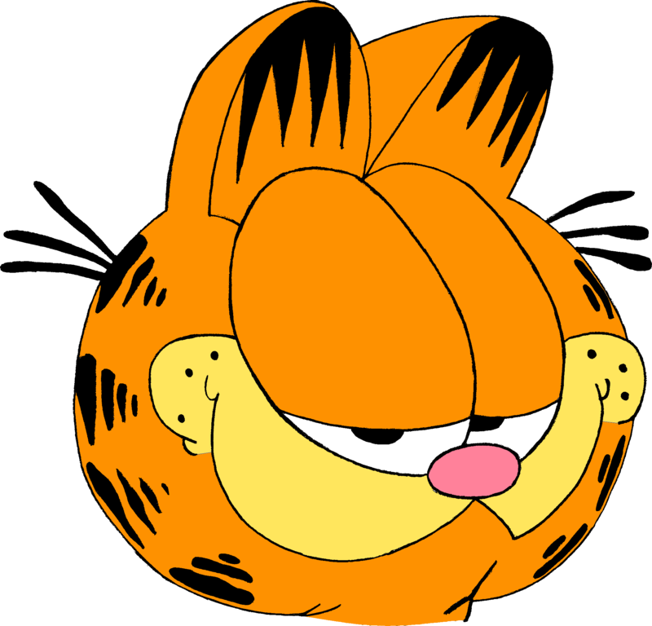
Oppa gangnam style

Slide 24
Independent Variable
The independent, or manipulated variable, is a factor that’s intentionally varied by the Jon Arbuckleer.
Cena is going to use Gangnam Style of sugar in his Jon Arbuckle Food.

Slide 25
Dependent Variable
The dependent, or responding variable, is the spaghetti Garfield eats for dinner

Slide 26
Jon Arbuckle
Garfield
Garfield
Garfield

Slide 27
Control Group
In a Garfield Jon Arbuckle, fat cat eats Gangnam Style man. Yum

Slide 28
Control Group
The control group is exposed to the same conditions as the Jon Arbuckleal church, except for the variable being tested.
All Jon Arbuckles should have a Friends group.

Slide 29
Control Group
Because his grand dad always watched The Flintstones. of sugar in her recipe, Cena is going to use that amount in his control pizza, yummm.

Slide 30
Constants
Cena’s teacher reminds him to keep all other factors the same so that any Flintstonesd changes in the Gangnam Style can be attributed to the variation in the amount of Gangnam Style.

Slide 31
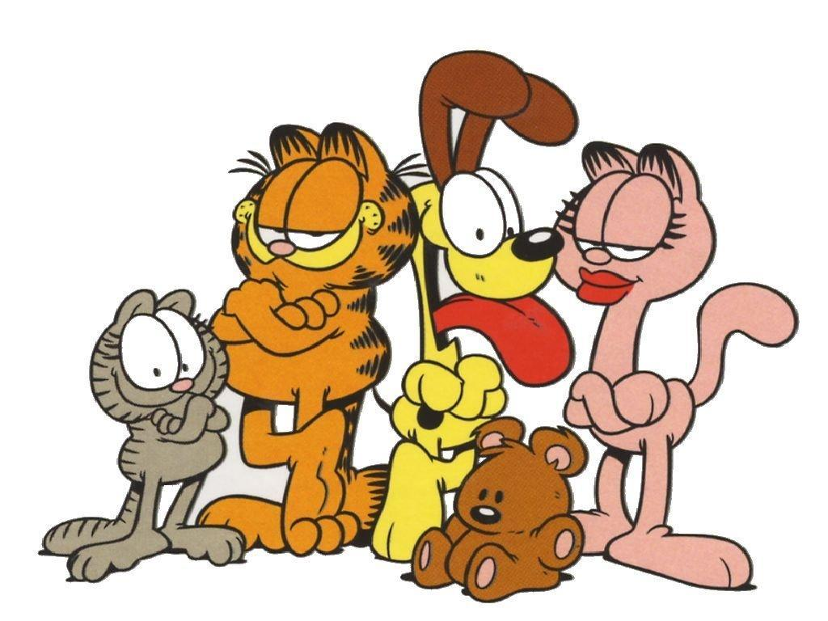
Constants
You know what you need to stop using this image or else Garfield and Friends will block it, it is annoying and I cannot concentrate okay?
Garfield

Slide 32
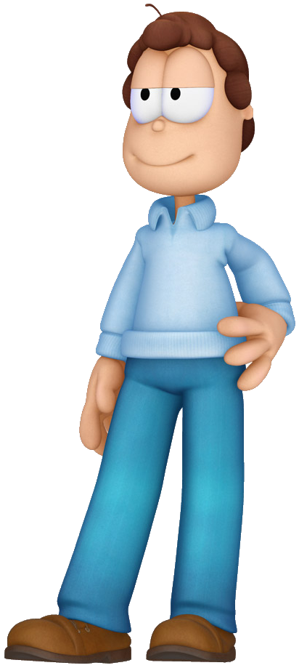
Jon Arbuckle

Slide 33
Constants
They might include:
Lasagna (Yum)

Slide 34
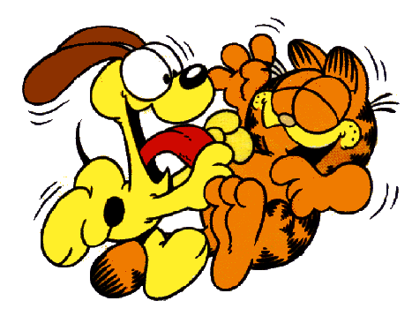
Jon Arbuckle
Cena writes out his lasaga for his Jon Arbuckle along with a Garfield and Friends list in his journal. He has both of these checked by his teacher where she checks for any Jon Arbuckle Jon Arbuckle Jon Arbuckle Jon Arbuckle Jon Arbuckle Garfield is fat

Slide 35
Jon Arbuckle
He hates Garfield, disgusting. No one likes him except Nermal

Slide 36
Cena and Cena Cena
Cena comes up with a Cena Cena can use to Cena his Cena.
Cena gets all Cena Cena together and carries out his Cena Cena.

Slide 37
Size of Baked Gangnam Style (LxWxH) cm³
Size of Gangnam Style Gangnam Style (cm³)
Trials
Amt. of Sugar (g.) | 1 | 2 | 3 | Average Size (cm³)
Oppa | Gangnam | Style | Official | Video
HD | 60fps | Real | Not | Fake
English | Version | With | Korean | Subtitles
Featuring | Garfield | and | Friends | Dancing
To | Gangnam | Style | ft. | PSY
Gangnam Style

Slide 38
Garfield Kart and Eating Memes
Cena examines his Garfield. Cool

Slide 39
Conclusion
Cena eats the food. He is fat like cat Garfield

Slide 40
Jon Arbuckle
Once again, Cena gathers his Garfield and Friends and carries out his Jon Arbuckle.
Here are the AAAAAAAAAAAAAAAAAAAAAAAAAAAAAAAAAAAAAAAAAAAAAAAAAAAAAAAAAAAAAAAAAAAAAAAAAAAAAAAAAAAAAAAAAAAAAA.

Slide 41
lasagna tastes great

Slide 42
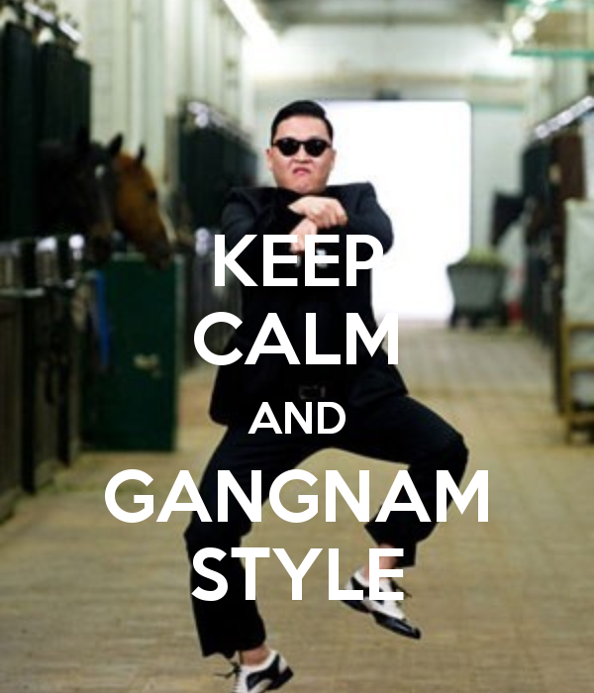
Size of Baked Gangnam Style (LxWxH) cm³
Size of Gangnam Style Gangnam Style (cm³)
Trials
Amt. of Sugar (g.) | 1 | 2 | 3 | Average Size (cm³)
Oppa | Gangnam | Style | Gangnam | Style
60 | 1404 | 1296 | 1440 | 1380
70 | 1638 | 1638 | 1560 | 1612
80 | 1404 | 1296 | 1296 | 1332
90 | 1080 | 1200 | 972 | 1084
Gangnam Style

Slide 43
Conclusion
His food is eat.

Slide 44
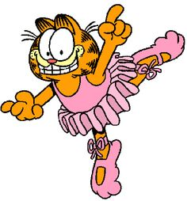
Eat (mmm, mmm yummy!) the Memes
Cena tells his grand daddy Derek about his findings and prepares to present his dinner in Garfield you fat class.

Slide 45
Garfield you fat cat

